Slide 1
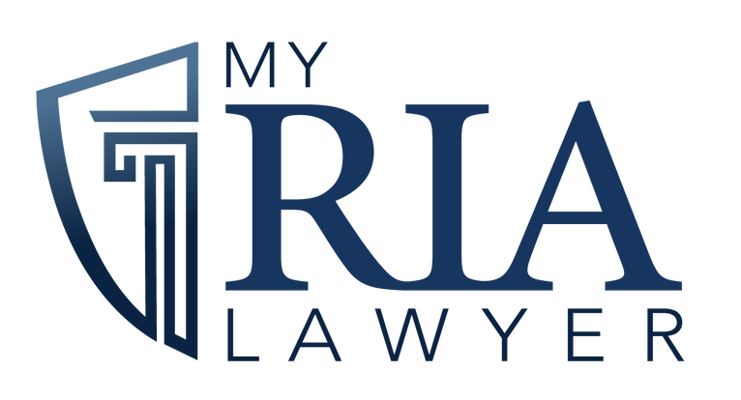
COMPLIANCE
MANUAL
WORKSHOP

Slide 2
CULTURE OF COMPLIANCE
“We think that every good culture of compliance has at least five elements. First, it has a strategic vision. Compliance activities have to relate to some larger strategic goal. Second, it identifies the specific risks that could arise within each strategic area. The devil, as they say, is in the details. Third, it establishes control points for each of these risks. Fourth, it is well documented. Documentation provides transparency, both internal, to senior management, and external, to auditors and regulators. Fifth and finally, specific people are accountable for managing each specific element of the compliance system. You can have the best policies and procedures in the world, but if no one is making them work, they will be useless.”
-Lori A. Richards, Former Director of OCIE

Slide 3
Welcome to the workshop
We will be determining what is missing, what needs to be improved and where additional training is needed.
GO TO www.myrialawyer.com/cpa-alliance
01 - UPDATE COMPLIANCE MANUAL
We will discuss best practices, recent Enforcement cases and risk alerts and guidance issued by state and federal regulators.
02 - BEST PRACTICES
03 - NETWORK AND SHARE INSIGHTS
You will have an opportunity to share with one another and receive feedback from me and each other.
Notes:
Icebreaker prompt: What’s the biggest compliance challenge you’ve faced this year?

Slide 4
AGENDA FOR
TODAY
8:00 AM - 8:30 AM: Registration & Welcome
8:30 AM - 10:15 AM: Core Requirements for Compliance Manuals
10:15 AM - 10:30 AM: Break
10:30 AM - 12:00 PM: Policies & Procedures: What You Must Have
1:00 PM - 2:30 PM: Recent Regulatory Updates
2:30 PM - 2:45 PM: Break
2:45 PM - 4:15 PM: Testing and Monitoring Your Program
4:00 PM - 4:45 PM: Specialized Topics
4:45 PM - 5:00 PM: Wrap-Up and Next Steps

Slide 5
KEY ELEMENTS OF A MANUAL
Trading practices
Safeguarding
Disclosures
Trading practices, including procedures by which you satisfy your best execution obligation, use client brokerage to obtain research and other services (referred to as “soft dollar arrangements”), and allocate aggregated trades among clients
Safeguarding of client assets from conversion or inappropriate use by your personnel.
Safeguards for the privacy protection of client records and information.
The accuracy of disclosures made to investors, clients, and regulators, including account statements and advertisements
Valuation and Fees
Processes to value client holdings and assess fees based on those valuations
2
4
6
8
1
3
5
7
Portfolio Management
Proprietary Trading
Records
Marketing
Processes, including allocation of investment opportunities among clients and consistency of portfolios with clients’ investment objectives, your disclosures to clients, and applicable regulatory restrictions
Proprietary trading by you and the personal trading activities of your supervised persons
The accurate creation of required records and their maintenance in a manner that secures them from unauthorized alteration or use and protects them from untimely destruction
Marketing advisory services, including the use of solicitors
Notes:
As a registered investment adviser, you are required to adopt and implement written policies and procedures that are reasonably designed to prevent violations of the Advisers Act. The Commission has said that it expects that these policies and procedures would be designed to prevent, detect, and correct violations of the Advisers Act. You must review those policies and procedures at least annually for their adequacy and the effectiveness of their implementation, and designate a chief compliance officer (“CCO”) to be responsible for administering your policies and procedures (under the “Compliance Rule” — Rule 206(4)-7).
Interactive Exercise:
Highlight missing policies in the provided sample compliance manual.

Slide 6
Tailored to your firm:
Policies should be customized to your unique business model, products, services, and operations to effectively address your specific compliance needs.
Clear and concise:
Use plain language to avoid ambiguity and ensure everyone understands their responsibilities.
Risk-based approach:
Focus on identifying and mitigating key compliance risks relevant to your firm.
Detailed procedures:
For complex activities, provide specific steps on how to execute tasks correctly.
Regular review and updates:
Periodically assess and revise policies to reflect changing regulations and business practices.
Conflict of interest management:
Clear guidelines on how to identify, disclose, and manage potential conflicts of interest.
Client onboarding and due diligence:
Detailed procedures for gathering necessary client information and conducting suitability assessments
.
Investment recommendation process:
Specific criteria for evaluating investments and documenting rationale behind recommendations.
Cybersecurity protocols:
Defined measures for protecting client data and systems from cyber threats
HOW TO DRAFT
POLICIES AND PROCEDURES

Slide 7
MUST HAVE
POLICIES AND PROCEDURES
Cybersecurity Policy:
Importance of a comprehensive plan
Example: Incident response protocol
Business Continuity Plan (BCP) and Succession Plan:
Maintaining operations during disruptions
Passing of leadership responsibilities
Code of Ethics:
Outlines minimum conduct standards for employees, emphasizing fiduciary obligations and preventing conflicts of interest related to personal trading.
Insider Trading:
Preventative measures and red flags

Slide 8
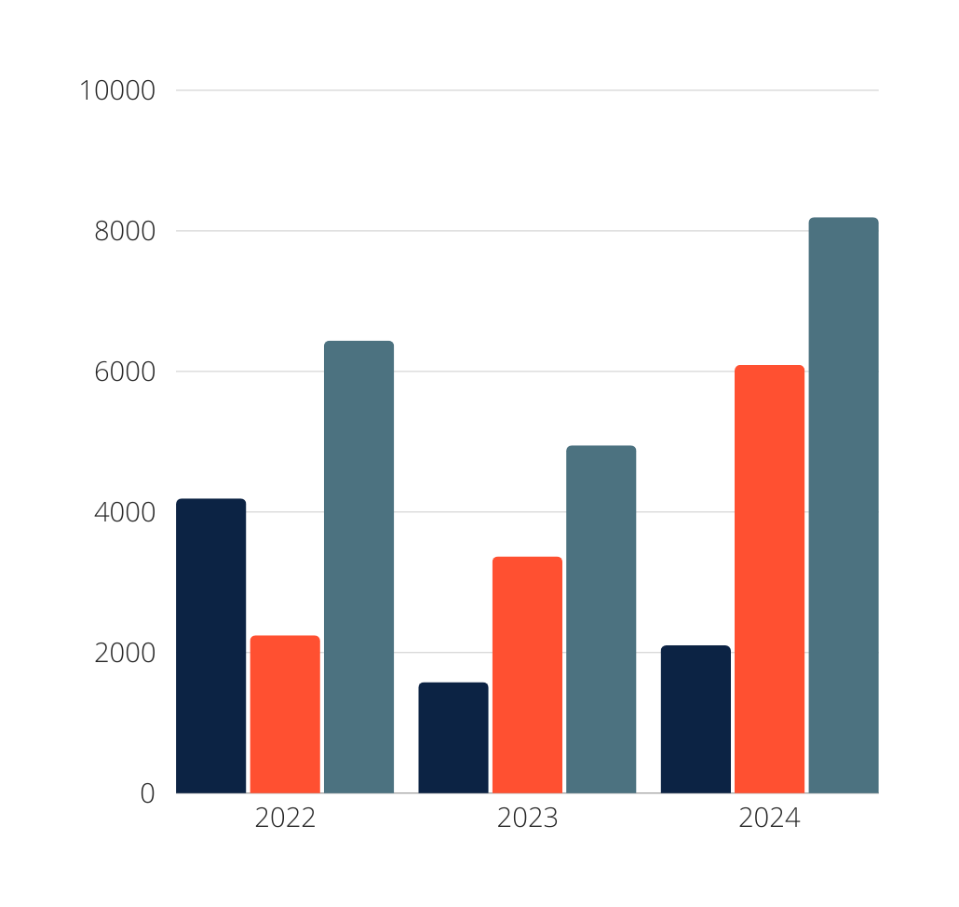
SEC ENFORCEMENT
The SEC obtained orders barring 124 individuals from serving as officers and directors of public companies, the second-highest number of such bars obtained in a decade.
01 - FINES
02 - DISGORGEMENT
03 - TOTAL
Notes:
The 583 enforcement actions represent a 26 percent decline in total enforcement actions compared to fiscal year 2023.
The $8.2 billion in financial remedies consisted of $6.1 billion in disgorgement and prejudgment interest, also the highest amount on record, and $2.1 billion in civil penalties, the second-highest amount on record.

Slide 9
omitted procedures to enforce stated policies, such as stating the advisers’ policy is to seek best execution, but not having any procedures to evaluate periodically and systematically the execution quality of the broker-dealers executing their clients’ transactions
did not adequately address certain risk areas applicable to the firm, such as portfolio management and fee billing
were not followed by advisory personnel, typically because the personnel were not aware of the policies or procedures or the policies or procedures were not consistent with their businesses or operations
Used off-the-shelf compliance manuals that were not tailored for consistency with the advisers’ operations and business lines
advisers may have assigned additional and unrelated responsibilities to the chief compliance officer (“CCO”), resulting in limited time for the CCO to dedicate to compliance)
undisclosed conflicts of interest created by the multiple roles and responsibilities of advisory personnel carrying out the assigned duties, and these conflicts were not mitigated
Lorna Alvarado
WHAT ELSE IS MISSING?

Slide 10
DEVELOPING A TESTING PRGRAM
UNDERSTAND REGULATORY REQUIREMENTS
6. PERFORM TESTING
2. ASSESS THE FIRM’S BUSINESS MODEL
7. DOCUMENT FINDINGS
10. REVIEW AND UPDATE PROGRAM
3. ESTABLISH A TESTING PLAN
8. ADDRESS DEFICIENCIES
11. STAY PROACTIVE
4. DEVELOP TESTING PROCEDURES
9. REPORT RESULTS
5. ASSIGN RESPONSIBILITIES
Notes:
1. Understand Regulatory Requirements
Familiarize yourself with the relevant regulations, including the Investment Advisers Act of 1940 for SEC-registered advisers or applicable state regulations.
Identify specific rules that require testing, such as custody, advertising, Form ADV disclosures, and fiduciary duties.
2. Assess the Firm’s Business Model
Evaluate the RIA's services, client base, investment strategies, and operational structure.
Consider potential areas of regulatory risk specific to the firm’s activities, such as private fund management, custody of client funds, or use of third-party vendors.
3. Establish a Testing Plan
Identify Key Areas: Focus on high-risk areas and regulatory hot topics, like compliance with the SEC’s Marketing Rule or cybersecurity preparedness.
Frequency of Testing: Determine the cadence (e.g., daily, monthly, quarterly, annually) based on the risk level of each compliance area.
Documentation Requirements: Specify how test results will be recorded and maintained.
4. Develop Testing Procedures
Define clear steps for testing each compliance area. For example:
Email Reviews: Randomly sample communications to ensure no off-channel violations or unapproved marketing.
Custody Rule Compliance: Verify timely delivery of audited financials and accuracy of client statements.
Form ADV Reviews: Cross-check disclosures against firm activities and client agreements.
5. Assign Responsibilities
Designate specific team members or departments to conduct the tests.
Provide training to ensure those performing tests understand the requirements and procedures.
6. Perform Testing
Implement the plan by conducting tests as scheduled.
Use compliance software like Smart RIA or other tools to facilitate tracking and reporting.
7. Document Findings
Record all testing activities, findings, and any identified deficiencies.
Include supporting documentation, such as reports, logs, or screenshots.
8. Address Deficiencies
Develop and implement corrective actions for any issues identified during testing.
Ensure remediation is timely and adequately documented.
9. Report Results
Compile testing results into a report for the Chief Compliance Officer (CCO) and senior management.
Highlight significant issues and progress on remediation efforts.
10. Review and Update the Program
Periodically assess the effectiveness of the compliance testing program.
Adjust the plan as needed based on changes in regulations, firm activities, or testing results.
11. Stay Proactive
Monitor regulatory updates and enforcement actions to identify emerging risks.
Incorporate new testing areas to address evolving regulatory focus.

Slide 11
OFF CHANNEL COMMUNICATIONS
Northwestern Mutual Investment Services LLC (NMIS), together with Northwestern Mutual Investment Management Co. LLC (NMIM) and Mason Street Advisors LLC (Mason Street) (collectively, Northwestern Mutual), agreed to pay a $16.5 million penalty;
Guggenheim Securities LLC (Guggenheim Securities), together with Guggenheim Partners Investment Management LLC (GPIM) (collectively, Guggenheim), agreed to pay a $15 million penalty;
Oppenheimer & Co. Inc. (Oppenheimer) agreed to pay a $12 million penalty;
Cambridge Investment Research Inc. (CIR), together with Cambridge Investment Research Advisors Inc. (CIRA) (collectively, Cambridge), agreed to pay a $10 million penalty;
Key Investment Services LLC (KIS), together with KeyBanc Capital Markets Inc. (KBCM) (collectively, Key), agreed to pay a $10 million penalty;
Lincoln Financial Advisors Corporation, together with Lincoln Financial Securities Corporation (collectively, Lincoln), agreed to pay an $8.5 million penalty;
U.S. Bancorp Investments Inc. (U.S. Bancorp) agreed to pay an $8 million penalty; and
The Huntington Investment Company (HIC), together with Huntington Securities Inc. (HSI) and Capstone Capital Markets LLC (Capstone) (collectively, Huntington), which self-reported, agreed to pay a $1.25 million penalty.
SEC Deputy Director Sanjay Wadhwa briefly discussed the recent recordkeeping violations and settlements and addressed certain considerations that the SEC took into account when determining penalties with respect to recordkeeping-related violations. These included, but were not limited to:
Size of the firm “to ensure that the penalties are adequate to serve as a deterrent against future violations”
Number of registered professionals at the firm
Scope of the violation
The firm’s efforts to (a) comply with its own recordkeeping obligations and (b) prevent off-channel communications
Whether the firm self-reported or not
The firm’s cooperation during its investigation

Slide 12
MARKETING RULE
On September 9, nine firms settled charges for disseminating advertisements that included untrue or unsubstantiated statements or testimonials, endorsements or third-party ratings that lacked the required disclosures.
Combined, they paid $1,240,000 in fines:
Abacus Planning Group Inc. agreed to pay a civil penalty of $150,000;
AZ Apice Capital Management LLC agreed to pay a civil penalty of $70,000;
Beta Wealth Group, Inc. agreed to pay a civil penalty of $80,000;
Droms Strauss Advisors Inc. agreed to pay a civil penalty of $85,000;
Howard Bailey Securities LLC agreed to pay a civil penalty of $90,000;
Integrated Advisors Network LLC agreed to pay a civil penalty of $325,000;
Professional Financial Strategies Inc. agreed to pay a civil penalty of $60,000;
Richard Bernstein Advisors LLC agreed to pay a civil penalty of $295,000; and
TS Bank d/b/a Callahan Financial Planning agreed to pay a civil penalty of $85,000
Notes:
Abacus and Callahan Financial published advertisements with untrue statements about third-party ratings and that Callahan Financial posted an advertisement falsely claiming that it was a member of an organization that did not exist.
AZ Apice, Callahan Financial, Droms Strauss, and Integrated Advisors disseminated advertisements that claimed to provide conflict-free advisory services, which the firms were not able to substantiate.
Beta Wealth disseminated advertisements that it could not substantiate regarding an award provided to a firm principal.
Howard Bailey disseminated advertisements claiming to contain two testimonials, but neither actually came from current clients. It also advertised endorsements that did not disclose that the endorser was a paid, non-client of Howard Bailey in videos, on social media, and on physical objects such as bags and flags.
Abacus, Beta Wealth, Professional Financial, and Richard Bernstein Advisors included in their advertisements third-party ratings, some of which were more than five years old, without disclosing the dates on which the ratings were given or the periods of time upon which the ratings were based.

Slide 13
NOW WHAT?

Slide 14
THANK YOU
www.myrialawyer.com/cpa-alliance

