Slide 1
Hype vs. Harm
Navigating the SEC’s Marketing Rule with Confidence

Slide 2
Learning Objectives
Understand the core provisions of the SEC Marketing Rule
Apply compliance best practices to real-world marketing scenarios
Recognize and avoid common violations through recent enforcement actions

Slide 3
Why This Matters
Marketing is a critical business driver
Rule 206(4)-1 impacts nearly all client-facing communications
SEC enforcement is on the rise
#1 – 92% of consumers read online reviews and testimonials when considering a purchase. (Vendasta)
#2 – 95% of people say that reviews – whether positive, or negative – influence their purchasing decisions. (Wyzowl)
#3 – 90% of buyers who read positive customer success content claimed that it influenced their purchasing decisions. (Dimensional Research)
#4 – Customer testimonials have the highest effectiveness rating for content marketing at 89%. (Social Fresh)
#5 – The regular use of testimonials can help you generate 62% more revenue from every customer, not just once, but every time they visit your site. (BigCommerce)
#6 – 88% of consumers trust online reviews as much as personal recommendations. (Search Engine Land)
#7 – 92% of people will trust a recommendation from a peer, and 70% of people will trust a recommendation from someone they don’t even know. (Nielsen)
#8 – 9 out of 10 people say they trust what a customer says about a business more than what that business says about itself. (Wyzowl)
#9 – 91% of millennials trust online reviews as much as friends and family. (BrightLocal)
#10 – 92% of consumers trust peer recommendations. (Search Engine Watch)

Slide 4
Overview of the Marketing Rule
Highlights
Testimonials and Endorsements
Effective May 4, 2021 (compliance by Nov 4, 2022)
Modernized Rule 206(4)-1 under the Advisers Act
Replaces and consolidates Advertising Rule and Cash Solicitation Rule
The new rule defines a testimonial as any statement by a current client about the client’s experience with the investment adviser or its staff that directly or indirectly solicits or refers any current or prospective client to be a client of the investment adviser.
The new rule defines an endorsement as any statement by a person other than a current client advised by the investment adviser that indicates approval, support, or recommendation of the investment adviser or its staff or describes that person’s experience with the investment adviser or its staff; directly or indirectly solicits or refers any current or prospective client or investor to be a client of the investment adviser.

Slide 5
Definition of an Advertisement
Disclosures for Testimonials
Two prongs:
Communications to more than one person (general advertising)
Endorsements/testimonials for compensation
Applies to websites, social media, email blasts, podcasts, etc.
Clearly and prominently, within the testimonial or endorsement that a current client or investor gave the testimonial, or someone other than a current client or investor gave the endorsement;
Clearly and prominently, within the testimonial or endorsement that the person providing the testimonial or endorsement received cash or non-cash compensation for doing so; and
Clearly and prominently, within the testimonial or endorsement any material conflicts of interest on the part of the person providing the testimonial or endorsement stemming from their relationship with the RIA.

Slide 6
Seven Prohibitions
Untrue statements or omissions
Unsubstantiated statements
Cherry-picking performance
Misleading time periods
Misleading comparisons
Misleading client experience
Hypothetical performance without conditions

Slide 7
Third-Party Ratings
Disclosure example
Shaver Wealth has been recognized by Financial Planning Magazine as One of the Top 100 Financial Advisors in 2025.
Disclosure of Criteria and Limitations: This rating was issued by Financial Planning Magazine , an independent organization that [briefly describe the organization, e.g., publishes financial services rankings or evaluates financial professionals based on specific criteria].
Date of Rating or Award: [MM/DD/YYYY]
Time Period Covered by the Rating (if applicable): [e.g., "2024 calendar year"]
Evaluation Criteria: [e.g., assets under management, client retention rate, regulatory record, client reviews, etc.]
Weighting of Criteria (if known): [e.g., 40% based on AUM, 30% on compliance record, etc.]
Compensation Provided: [State whether the firm or any related individual paid a fee to be considered for the rating, or to use the rating in marketing. If yes, specify.] Example: No compensation was provided in connection with obtaining or using this rating.
Important Considerations:
This rating is not indicative of any future performance or success.
Third-party rankings do not guarantee that a client or prospective client will experience a particular level of results if they engage with our firm.
Rankings should not be construed as an endorsement by any client or by any regulatory authority.
For additional information about the methodology used by Financial Planning Magazine, please visit: [Insert link to rating methodology or disclosure page if available].
Permitted if:
Rating is from a legitimate source
Clear disclosure of criteria and compensation
Designed to prevent misleading impressions

Slide 8
Performance Advertising Requirements
Disclosure example
Gross vs. Net performance
Prescribed time periods (1-, 5-, 10-year)
Hypothetical, extracted, and related performance rules
Key Assumptions & Limitations:
Time Period Covered: Performance data reflects the period from [start date] to [end date].
Calculation Methodology: Returns are calculated using [describe methodology, e.g., time-weighted returns, internal rate of return, daily/monthly performance, etc.].
Fees & Expenses:
If Gross: The performance is gross of advisory fees and other expenses. Client returns will be reduced by these costs.
If Net: The performance is net of the highest applicable advisory fee charged by [Firm Name] and includes brokerage commissions and other expenses.
Important Disclosures:
Past performance is not indicative of future results. There is no assurance that any investment strategy will achieve its objectives or that any client will achieve similar results.
Performance may vary materially depending on market conditions, asset allocation, and specific client constraints.
If Hypothetical/Model Performance: The performance presented is hypothetical and does not reflect actual trading in client accounts. Hypothetical results are provided for illustrative purposes only and have inherent limitations, including the benefit of hindsight and the inability to account for the impact of actual trading and market conditions.
If Extracted Performance: The performance shown is extracted from one or more accounts managed by [Firm Name] and does not represent the performance of any single client. The performance may not reflect the actual experience of any specific client.
If Related or Representative Performance: The performance results presented relate to one or more accounts with investment objectives and strategies substantially similar to those of prospective clients. Not all client accounts are managed in the same manner, and performance may vary.

Slide 9
Social Media & Websites
Compliance Testing
Applies to all public content
Personal LinkedIn = for business platform
Sharing business content on personal profiles
Comment moderation and archiving responsibilities
At least monthly reviews
Check out settings
Training with your staff and IARs

Slide 10
Policies and Procedures
Firms must adopt and implement written policies
Supervision and pre-approval processes
Archiving and recordkeeping

Slide 11
Enforcement Trends
SEC has started to charge standalone marketing rule violations
Focus on:
Hypothetical performance
Testimonials without proper disclosures
Unsubstantiated claims
Abacus and Callahan Financial published advertisements with untrue statements about third-party ratings and that Callahan Financial posted an advertisement falsely claiming that it was a member of an organization that did not exist.
AZ Apice, Callahan Financial, Droms Strauss, and Integrated Advisors disseminated advertisements that claimed to provide conflict-free advisory services, which the firms were not able to substantiate.
Beta Wealth disseminated advertisements that it could not substantiate regarding an award provided to a firm principal.
Howard Bailey disseminated advertisements claiming to contain two testimonials, but neither actually came from current clients. It also advertised endorsements that did not disclose that the endorser was a paid, non-client of Howard Bailey in videos, on social media, and on physical objects such as bags and flags.
Abacus, Beta Wealth, Professional Financial, and Richard Bernstein Advisors included in their advertisements third-party ratings, some of which were more than five years old, without disclosing the dates on which the ratings were given or the periods of time upon which the ratings were based.

Slide 12
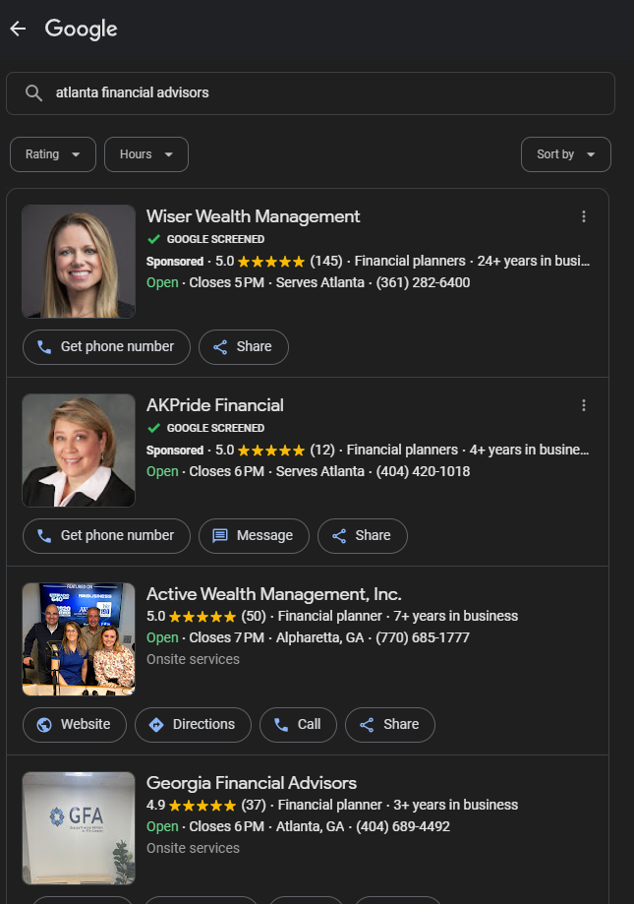
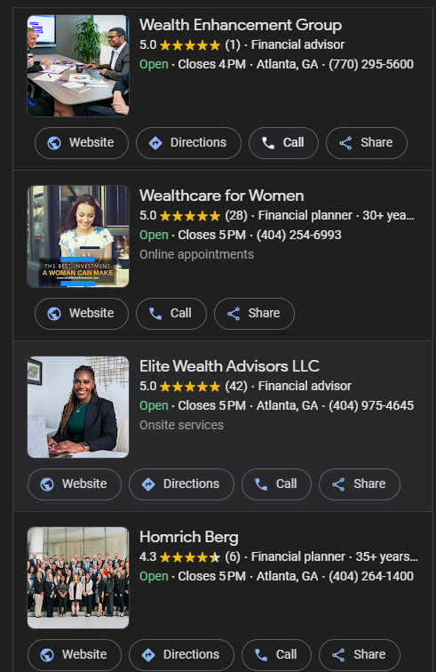
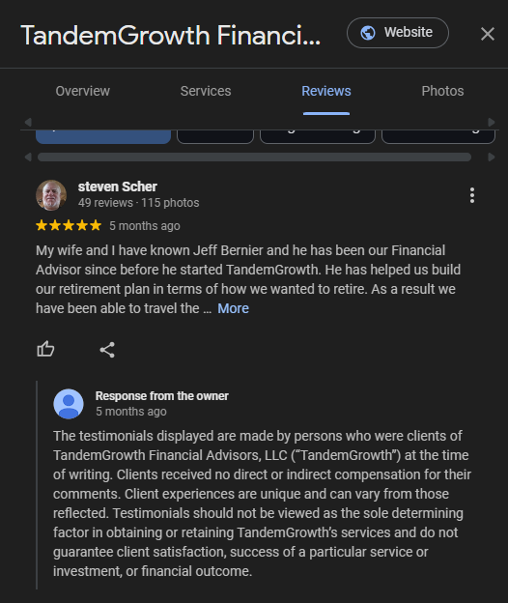
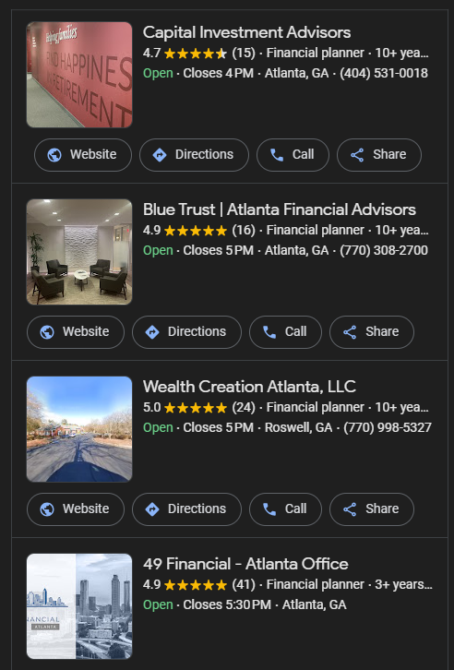
Case Study 1
Out of 20 firms reviewed, 1 had the appropriate disclosures

Slide 13
Case Study 2
$200,000 in combined penalties
Findings
GeaSphere LLC
Bradesco Global Advisors Inc.
Credicorp Capital Advisors LLC
InSight Securities Inc.
Monex Asset Management Inc.
The five firms advertised hypothetical performance to the general public on their websites without adopting and implementing policies and procedures reasonably designed to ensure that the hypothetical performance was relevant to the likely financial situation and investment objectives of each advertisement’s intended audience
GeaSphere violated other regulatory requirements, including by making false and misleading statements in advertisements, advertising misleading model performance, being unable to substantiate performance shown in its advertisements, and failing to enter into written agreements with people it compensated for endorsements
GeaSphere committed recordkeeping and compliance violations and made misleading statements about its performance to a registered investment company client and that the misleading statements were included in the client’s prospectus filed with the Commission.

Slide 14
Case Study 3-
Twenty Acre Capital, LP
Findings
$100,000 in fines
Under the Marketing Rule, an advertisement disseminated directly or indirectly by an RIA may not
(1) Include any untrue statement of a material fact, or omit to state a material fact necessary in order to make the statement made, in the light of the circumstances under which it was made, not misleading;
… [or] (6) Include or exclude performance results, or present performance time periods, in a manner that is not fair and balanced.
Disseminated misleading performance advertising to prospective investors by advertising returns experienced by a single investor without disclosing that the returns did not constitute overall fund performance
It was a representative investor’s account, which, at times, substantially differed from the overall performance of the fund

Slide 15
Lessons Learned
Disclose everything
Document all marketing-related decisions
Train advisors and staff
Monitor evolving SEC guidance

Slide 16
Practical Steps to Comply
Conduct a marketing audit
Review and revise policies
Implement training and supervision
Stay on top of updates and enforcement

Slide 17
Q & A
Send your questions to:
www.myrialawyer.com
(770) 462-2118
leila@myrialawyer.com
Leila Shaver,
Chief Compliance Nerd

